Slide 1

Department of Computer Science and Engineering
Towards Smarter Agriculture: Deep Learning-Based Multistage Detection of Leaf Diseases
PRESENTED BY
Koyyalamudi Venkata Ramesh (22471A0533)
Bangaru Surya Prasad (22471A0557)
Thullibilli Nagaiah (22471A0561)
Shaik Abdul Nabi (22471A0547)
Under the Guidance of,
Dr.S.N.Thirumala Rao M.Tech , Ph.D. ,
Professor ,
Department of Computer Science and Engineering,
Narasaraopeta Engineering College (Autonomous),
Narasaraopet- 522 601.

Slide 2
OUTLINE
Abstract
Introduction
Literature Survey
Research Gaps
Problem Statement
Objectives
Block Diagram / Flow Diagram
Methodology
Implementation
Results and Analysis
Conclusion & Future Scope
References
Acknowledgements
Question and Answers

Slide 3
ABSTRACT
The project uses PlantVillage Dataset with 10 classes and 200 images each for balanced training. Image preprocessing includes resizing and CLAHE to enhance image quality and highlight disease features. PCFAN extracts key features, while EfficientNet-B0 classifies leaf diseases using transfer learning.
The model achieved 97.9% test accuracy and 96.2% validation accuracy, with precision, recall, and F1-scores above 95%. Red Fox Optimization accurately segments diseased regions, achieving 94% segmentation accuracy for reliable early detection.

Slide 4
INTRODUCTION
Agriculture is the backbone of the Indian economy, yet plant diseases continue to cause major crop losses for farmers. Early and accurate detection of leaf diseases is essential to prevent yield reduction and ensure sustainable farming. This project introduces a deep learning–based multistage framework for smart agriculture that automatically detects and classifies plant leaf diseases from images. Using the PlantVillage dataset, images are preprocessed through resizing and enhancement, then analyzed using EfficientNet-B0 for classification and Red Fox Optimization for segmentation of diseased areas. The system provides a reliable, fast, and efficient solution that helps farmers identify crop diseases at an early stage, promoting better management and healthier yields.

Slide 5
LITERATURE SURVEY
No | Title | Author | Journal Name & Year | Methodology Adapted | Key Findings | Gaps
1 | Deep Learning for Accurate Plant Disease Classification Using ResNet50 | M. Kumar, A. Arora, A. Deb, and A. L. Yadav | ICCICA,2024 | ResNet-50 CNN architecture, transfer learning, fine-tuning pretrained weights, multi-layer feature extraction, softmax classification | Achieved high accuracy for tomato leaf disease detection | Limited field-data performance
2 | Real-time Plant Disease Detection Using Deep Learning | D. S. Joseph, P. M. Pawar, and K. Chakradeo | IEEE Access,2024 | Deep CNN model, feature extraction layers, activation + pooling layers, real-time inference pipeline for disease detection | Real-time crop disease detection pipeline | Needs faster inference on mobile devices

Slide 6
LITERATURE SURVEY
No | Title | Author | Journal Name & Year | Methodology Adapted | Key Findings | Gaps
3 | EfficientNet-based Vegetable Quality Grading | M. Wen and J. He | Frontires,2024 | EfficientNet architecture, compound scaling technique, optimized depth/width/resolution, light-weight classifier | Lightweight and fast classification model | Not tested on disease datasets
4 | Plant Leaf Disease Detection Using Deep Learning (Multi-Dataset) | J. Shettigere Krishna et al | Sensors / 2025 | Custom CNN architecture, multi-dataset training, dropout layers to avoid overfitting, softmax classifier | Works across multiple datasets | Needs segmentation for better localization
5 | Deep Semantic Network for Soybean Rust Segmentation | S. Woo, Z. Xi, F. Liu, W. Hu, H. Feng, and Q. Zhang | Frontiers,2024 | Deep semantic segmentation network, pixel-wise disease area mapping, multi-class segmentation layers | Accurate segmentation of infected soybean leaf regions | Limited crop types

Slide 7
RESEARCH GAPS
Lack of integrated frameworks : Our multistage deep learning model combines preprocessing, classification (EfficientNet-B0), and segmentation (RFO) into a unified system for accurate detection and localization.
High computational cost : Using the lightweight EfficientNet-B0 with optimized preprocessing, our approach ensures high accuracy with low resource usage suitable for real-time use.
Limited generalization : Enhanced preprocessing and contrast adjustment improve model robustness under different lighting, backgrounds, and disease conditions.

Slide 8
PROBLEM STATEMENT
Accurate detection of plant leaf diseases is challenging due to variations in lighting, background, and overlapping symptoms. This project proposes a deep learning-based multistage system using EfficientNet-B0 and Red Fox Optimization for automated, real-time, and precise leaf disease detection.
Key Challenges:
Variation In environmental conditions.
Overlapping Diseases.
Limited dataset diversity.

Slide 9
OBJECTIVES
To develop a deep learning–based multistage framework that integrates preprocessing, classification (EfficientNet-B0), and segmentation (Red Fox Optimization) for accurate detection of plant leaf diseases.
To enhance classification and segmentation performance through advanced preprocessing techniques like resizing, denoising, and CLAHE, ensuring high accuracy and robustness across multiple disease classes.
To design a lightweight and real-time model suitable for mobile and edge deployment, enabling practical use in smart and precision farming environments.

Slide 10
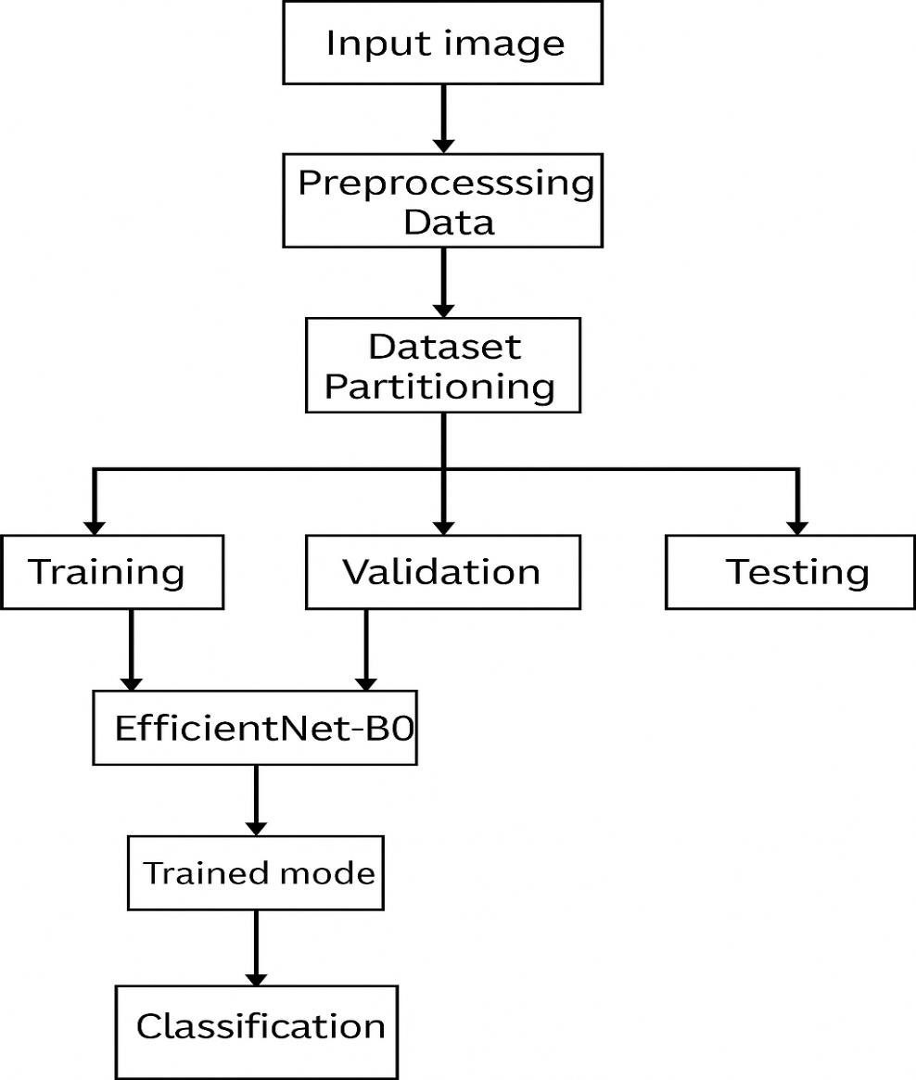
BLOCK DIAGRAM OR FLOW DIAGRAM

Slide 11
About Dataset
Large-Scale Leaf Image Collection:
Contains over 18,000 labeled images of plant leaves captured under controlled conditions.
38 Distinct Classes:
Includes healthy and diseased leaf categories across 14+ crop species, totaling 38 unique classes.
Standard Benchmark for Plant Disease Detection:
Widely used in machine learning and deep learning research for training and evaluating plant disease classification models.
High-Quality, Preprocessed Images:
Images are uniform in size and background, enabling consistent training and improving model performance.

Slide 12
METHODOLOGY
Data Collection:
PlantVillage dataset is collected from Kaggle
Link of dataset: https://www.kaggle.com/datasets/vipoooool/new-plant-diseases-dataset
Preprocessing Steps:
Resize to 224×224
Contrast enhancement using CLAHE
Image Enhancement
Normalization (0–1 scaling)

Slide 13
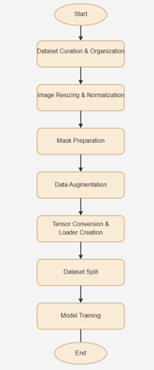
METHODOLOGY
The proposed methodology presents a deep learning-based multistage framework for detecting and segmenting plant leaf diseases. The PlantVillage dataset is preprocessed using resizing, normalization, denoising, and CLAHE to enhance image quality. Data augmentation techniques like rotation and flipping improve model generalization. EfficientNet-B0 is employed for accurate classification through transfer learning, while PCFAN extracts key features effectively. Red Fox Optimization (RFO) performs precise segmentation of diseased regions. The model is evaluated using accuracy, precision, recall, F1-score, and IoU metrics. Finally, the lightweight model is optimized for mobile and web deployment to enable real-time smart farming applications.

Slide 14
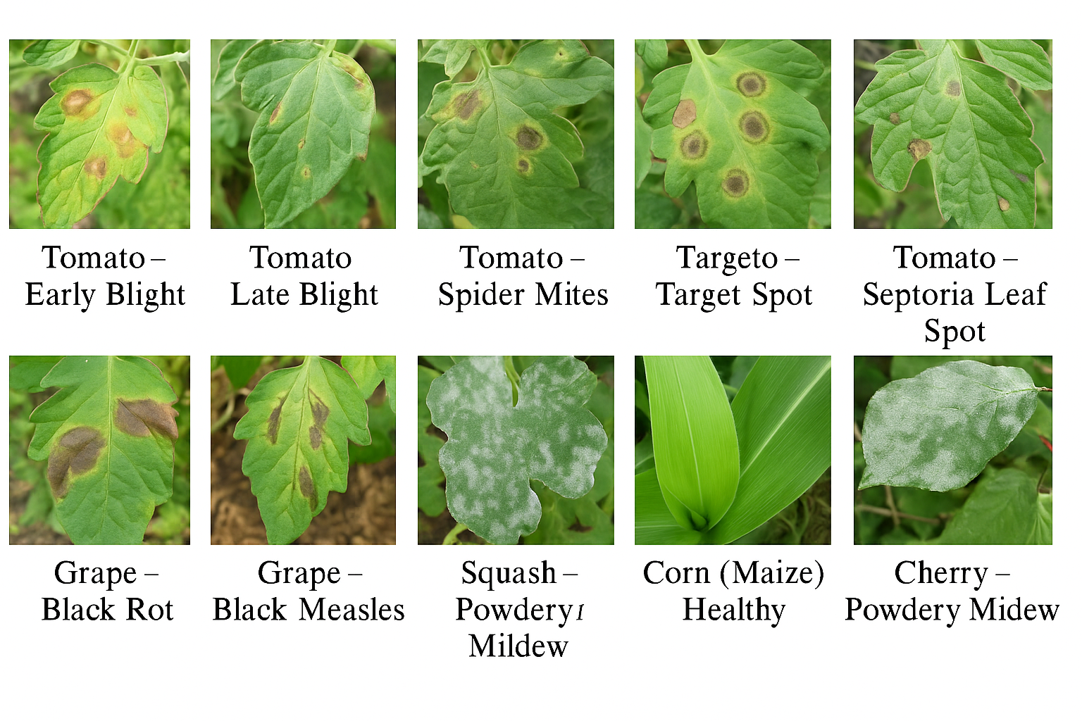
METHODOLOGY

Slide 15
METHODOLOGY
Why EfficientNetB0 Frame work used:
High accuracy with low computational cost
Lightweight and suitable for real-time use
Strong feature extraction with PCFAN
Precise segmentation using RFO
Good generalization across crops and conditions
Faster training with fewer resources

Slide 16
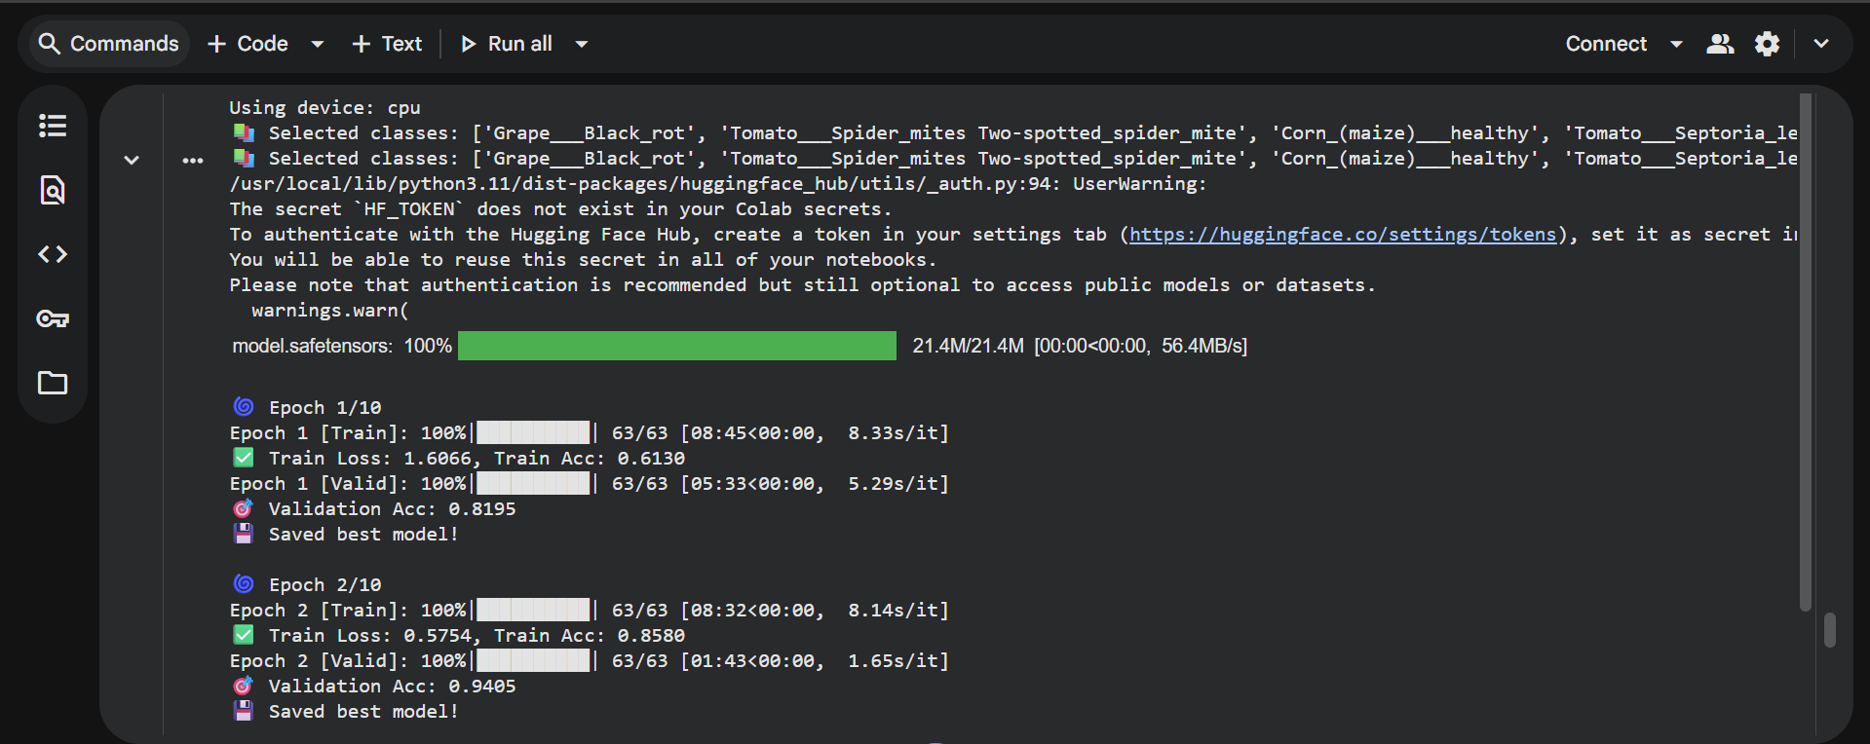
Implementation

Slide 17
Challenges Vs Overcomes
Challenges | Overcomes
Variation in lighting, background, and image quality | Applied CLAHE and denoising during preprocessing to enhance image clarity and uniformity
Overlapping or similar disease symptoms | Used EfficientNet-B0 with transfer learning for strong feature discrimination between diseases
High computational complexity of deep models | Implemented a lightweight EfficientNet-B0 architecture suitable for real-time applications
Difficulty in accurate segmentation of diseased regions | Utilized Red Fox Optimization (RFO) for precise and adaptive segmentation
Limited dataset diversity and imbalance | Performed data augmentation (rotation, flipping, scaling) to improve generalization
Lack of real-time applicability for farmers | Designed a deployable model compatible with mobile and web platforms for on-field use

Slide 18
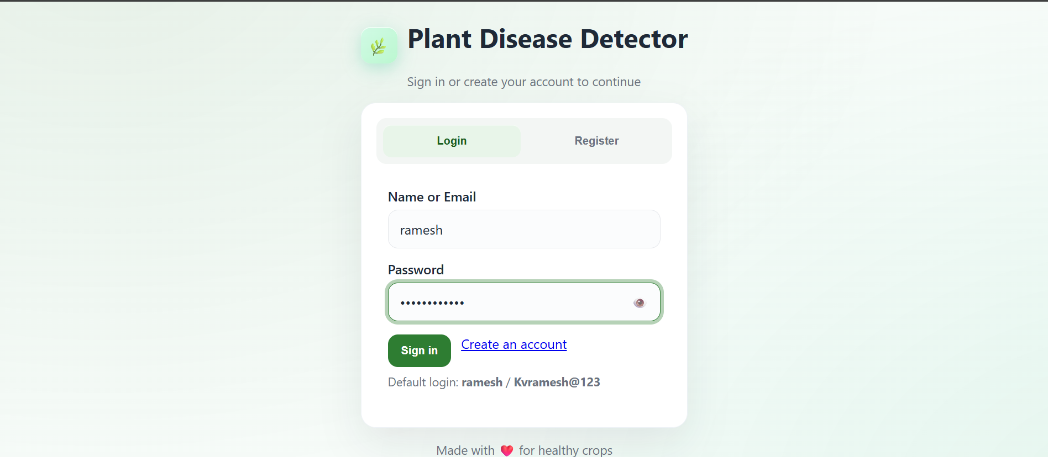
Implementation of Frontend

Slide 19
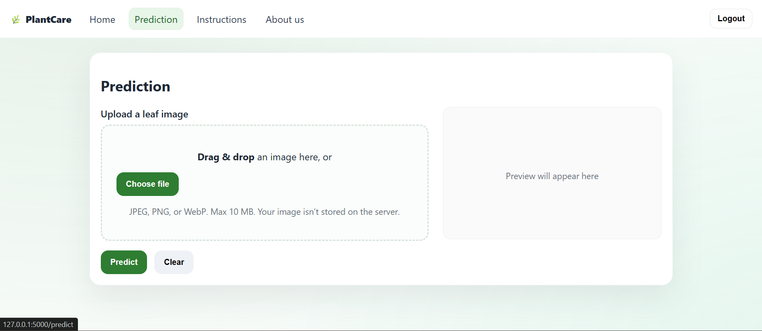
Implementation of Frontend

Slide 20
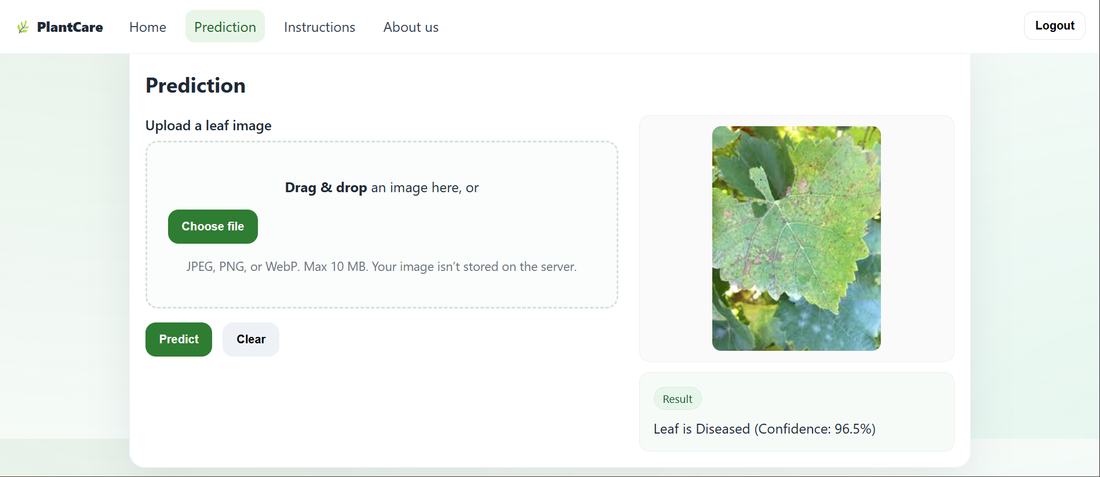
Implementation of Frontend

Slide 21
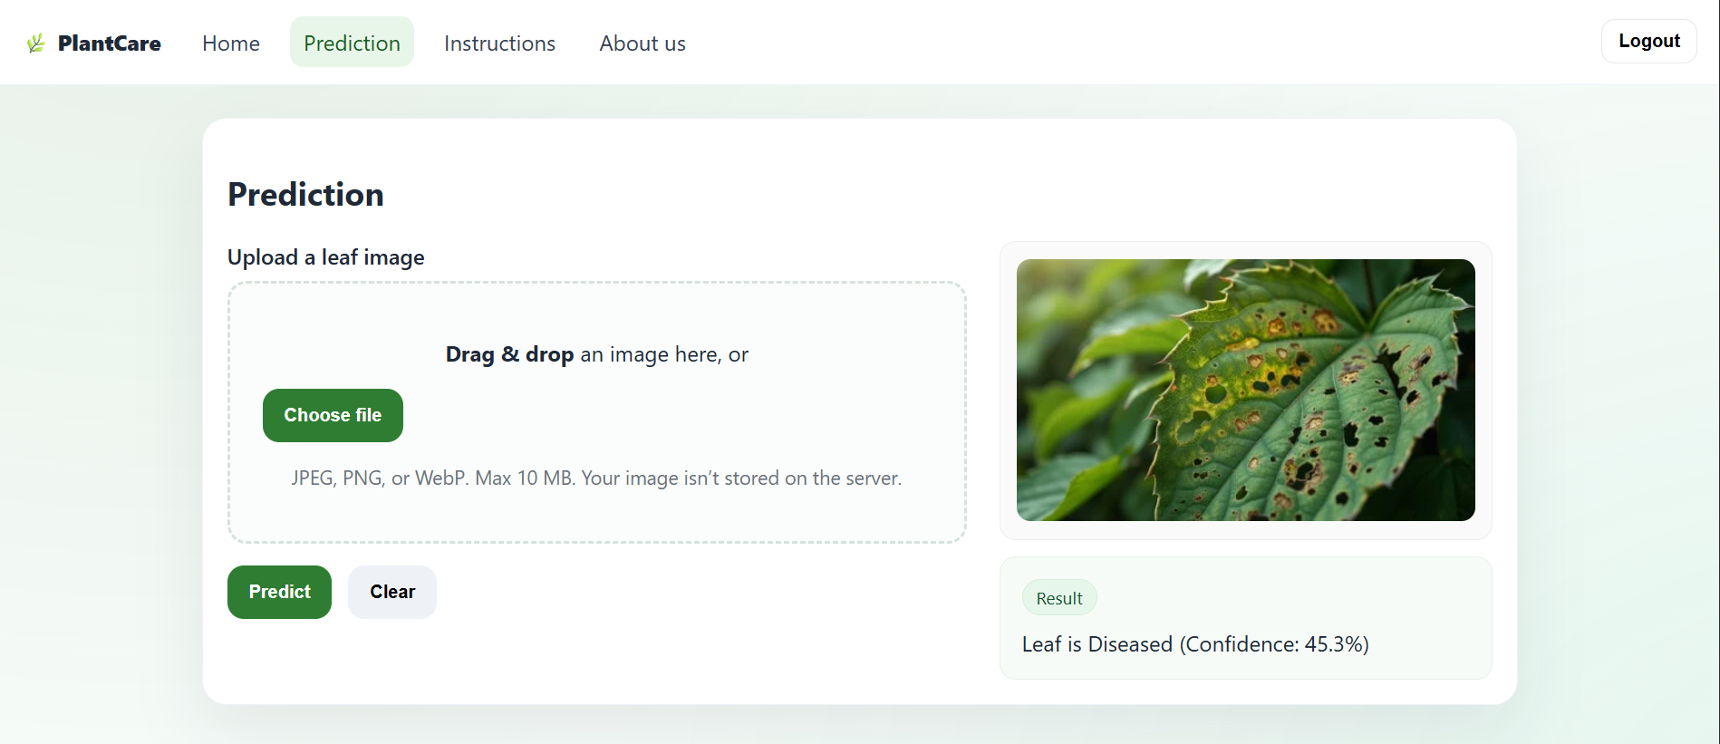
Implementation of Frontend

Slide 22

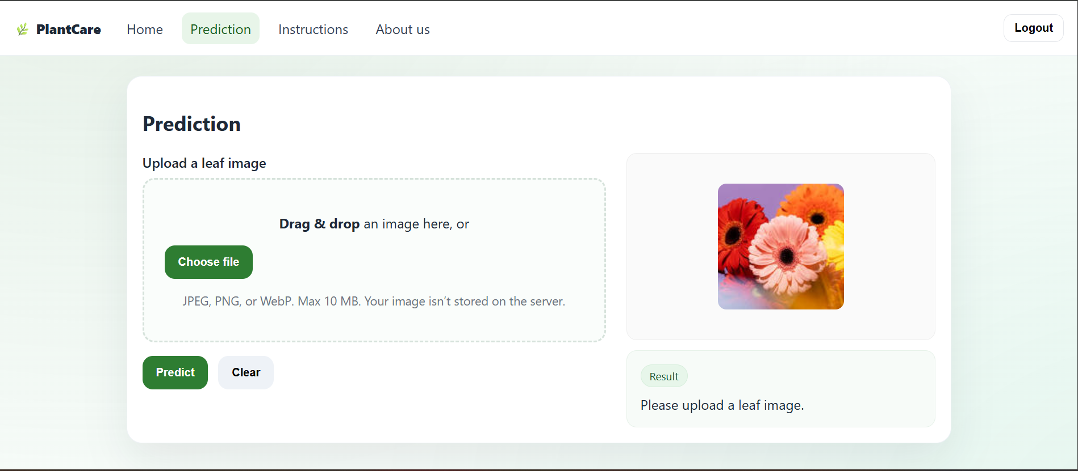
Implementation of Frontend

Slide 23
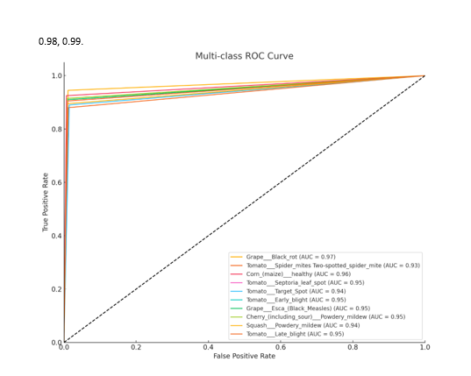
RESULTS & ANALYSIS
Metric / Parameter | Description / Observation | Result
Classification Accuracy (Test Set) | Accuracy achieved by EfficientNet-B0 on test images | 97.9%
Validation Accuracy | Model performance on unseen validation data | 96.2%
Precision | Correctly identified positive samples | Above 95%
Recall | Ability to detect all actual diseased samples | Above 95%
F1-Score | Balance between precision and recall | Above 95%
Segmentation Accuracy | Accuracy achieved by Red Fox Optimization in identifying infected regions | 94%

Slide 24
RESULTS & ANALYSIS
The EfficientNet-B0 model achieved a high test accuracy of 97.9% and a validation accuracy of 96.2%, demonstrating strong and consistent performance on both seen and unseen data.
Precision, Recall, and F1-Score all exceeded 95%, indicating that the model reliably identifies diseased samples while minimizing false predictions across all plant classes.
The multi-class ROC curve shows excellent AUC values ranging from 0.93 to 0.99, confirming the model’s strong ability to distinguish between different plant diseases.
The segmentation module achieved 94% accuracy using Red Fox Optimization, effectively highlighting infected regions and enhancing the interpretability of detection results.

Slide 25
RESULTS & ANALYSIS
Strong Classification Performance
High AUC Values (0.93–0.99)
Low False Positive Rate
Highest Accuracy for Specific Diseases

Slide 26
CONCLUSION & FUTURE SCOPE
Conclusion:
The proposed EfficientNet-B0 and Red Fox Optimization framework effectively detects and segments plant leaf diseases with high accuracy.
The model achieves strong performance across all metrics, ensuring reliable and early disease identification.
Future Scope:
Extend the system for multi-disease detection across various crops using real-field images.
Deploy the model on mobile and IoT-based smart farming platforms for real-time field diagnosis.

Slide 27
REFERENCES
M. Kumar, A. Arora, A. Deb, and A. L. Yadav, “Deep Learning for Accurate Plant Disease Classification Using ResNet50: A Comprehensive Approach,” Proc. 2024 Int’l Conf. Computational Intelligence and Computing Applications (ICCICA), May 2024.
D. S. Joseph, P. M. Pawar, and K. Chakradeo, “Realtime Plant Disease Dataset Development and Detection of Plant Disease Using Deep Learning,” IEEE Access, vol. 12, pp. 16310–16333, 2024.
M. Wen and J. He, “Agricultural Development Driven by the Digital Economy: Improved EfficientNet Vegetable Quality Grading,” Frontiers in Sustainable Food Systems, vol. 8, art. 1310042, Jan. 2024.
J. Shettigere Krishna et al., “Plant Leaf Disease Detection Using Deep Learning: A Multi Dataset Approach,” Sensors, vol. 8, no. 1, art. 4, Jan. 2025.
S. Woo, Z. Xi, F. Liu, W. Hu, H. Feng, and Q. Zhang, “A Deep Semantic Network Based Image Segmentation of Soybean Rust Pathogens,” Frontiers in Plant Science, vol. 15, art. 1340584, Jun. 2024.
S. Latif et al., “Detection and Classification of Various Diseases in Cotton Crops Using Advanced Neural Network Approaches,” Proc. 2024 Fourth Int’l Conf. Advances in Electrical, Computing, Communication and Sustainable Technologies (ICAECT), 2024.

Slide 28
REFERENCES
S. Latif et al., “Detection and Classification of Various Diseases in Cotton Crops Using Advanced Neural Network Approaches,” Proc. 2024 Fourth Int’l Conf. Advances in Electrical, Computing, Communication and Sustainable Technologies (ICAECT), 2024.
S. Bogireddy and H. Murari, “A Hybrid Deep Learning Model for Accurate Potato Leaf Disease Detection: Integration of U-Net and EfficientNetB7,” Proc. ICPECTS 2024, Oct. 2024.
J. Amara, B. König Ries, and S. Samuel, “Explainability of Deep Learning Based Plant Disease Classifiers Through Automated Concept Identification,” arXiv preprint, Dec. 2024.
P. E. Correa da Silva and J. Almeida, “An Edge Computing Based Solution for Real Time Leaf Disease Classification Using Thermal Imaging,” arXiv preprint, Nov. 2024.
S. N. T. Rao, T. C. Dulla, V. K. Kolla, G. S. Kurakula, M. Suneetha, S. Moturi, and D. V. Reddy, “Deep Learning-Based Tomato Leaf Disease Identification: Enhancing Classification with AlexNet,” Proc. 2025 IEEE Int. Conf. on Interdisciplinary Approaches in Technology and Management for Social Innovation (IATMSI), 2025.

Slide 29
ACKNOWLEDGEMENTS
We would like to express our sincere gratitude to the faculty and staff of Narasaraopeta Engineering College for their guidance and encouragement throughout the development of this project. Their insights and expertise have been invaluable.
We also extend our thanks to the administration for providing the necessary resources and a platform to showcase our work. This opportunity has been instrumental in enhancing our learning and growth.
For any questions or further discussions, feel free to reach out:-
Team No:AB6
Guide: Dr.S.N.Tirumala Rao
Roll No’s: 22471A0533
22471A0557
22471A0561
22471A0547
Thank You

Slide 30
System Requirements
Hardware Requirements
Processor : intel Core i5
Cache memory : 4MB(Megabyte)
RAM : 12.7GB (gigabyte)
Hard Disk : 166.8GB
Compute Engine : T4 GPU
Software Requirements
Operating System : Windows 10, 64-bit Operating System
Coding Language : Python
Python distribution : Google Colab , Flask
Browser : Any Latest Browser like Chrome

Slide 31


